Slide 1
Analysis of Kindle reviews in Amazon

Slide 2
^{Variables Introduction}
X (integer) - ID
asin (factor) - ID of the product, like B000FA64PK
helpful (factor) - helpfulness rating of the review - example: 2/3
overall (integer) - rating of the product.
reviewText (factor) - text of the review (heading)
reviewTime (factor) - time of the review (raw)
reviewerID (factor) - ID of the reviewer, like A3SPTOKDG7WBLN
reviewerName (factor) - name of the reviewer
summary (factor) - summary of the review (description)
unixReviewTime (integer) - unix timestamp
√
√
√

Slide 3
^{Focus}
product
number of product
relationship between comments number and rating based on each product
rating
time
rating distribution
relationship between rating and time

Slide 4
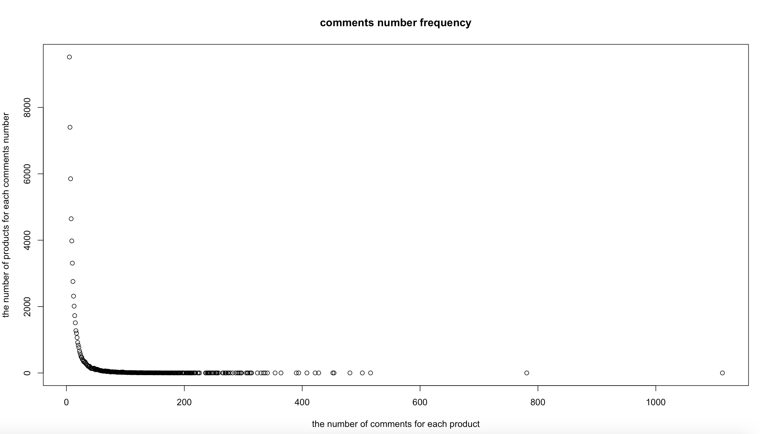
The number of review for each product
max 1113
minimum 5
mean 16
median 9

Slide 5
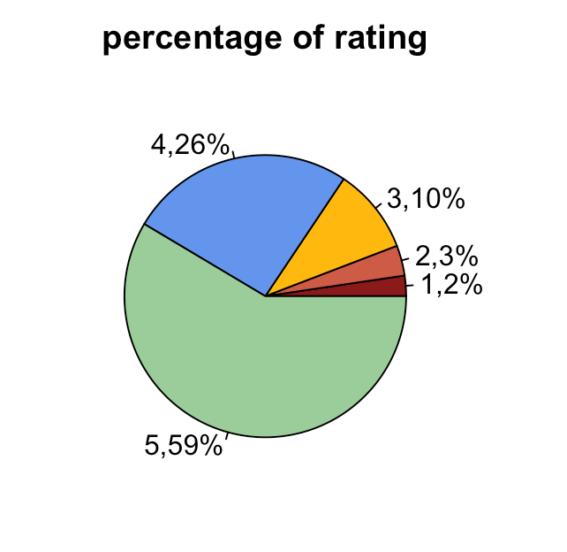
^{The rating of each review}
1: 23018
2: 34130
3: 96194
4: 254013
5: 575264

Slide 6
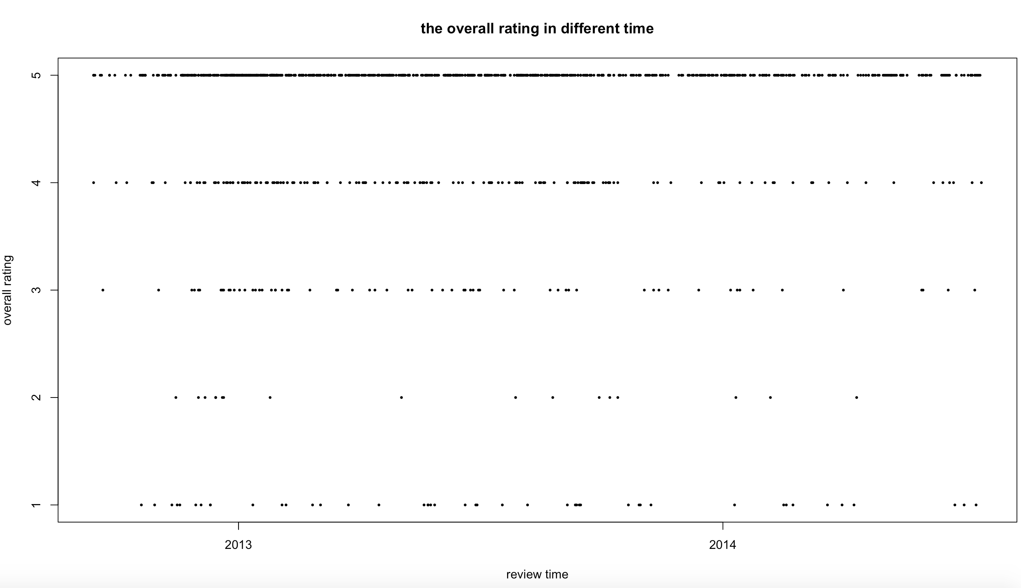
B006GWO5WK's overall rating changes in different time

Slide 7
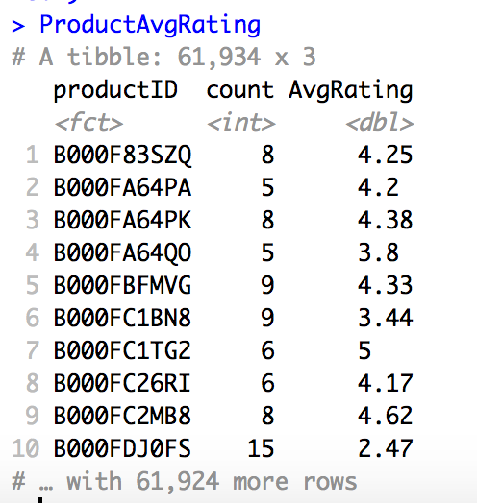
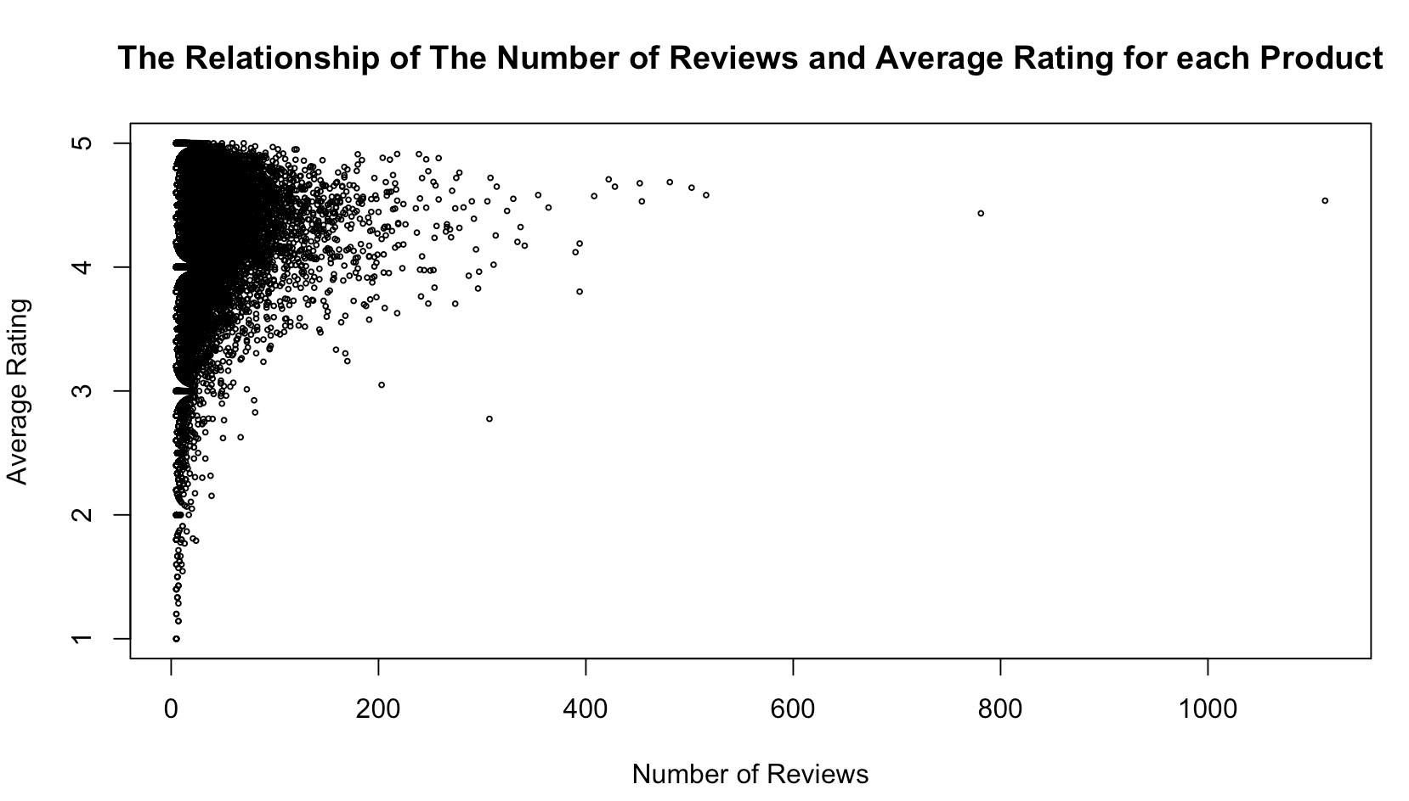
The relationship of number of reviews and average rating for each product

Slide 8
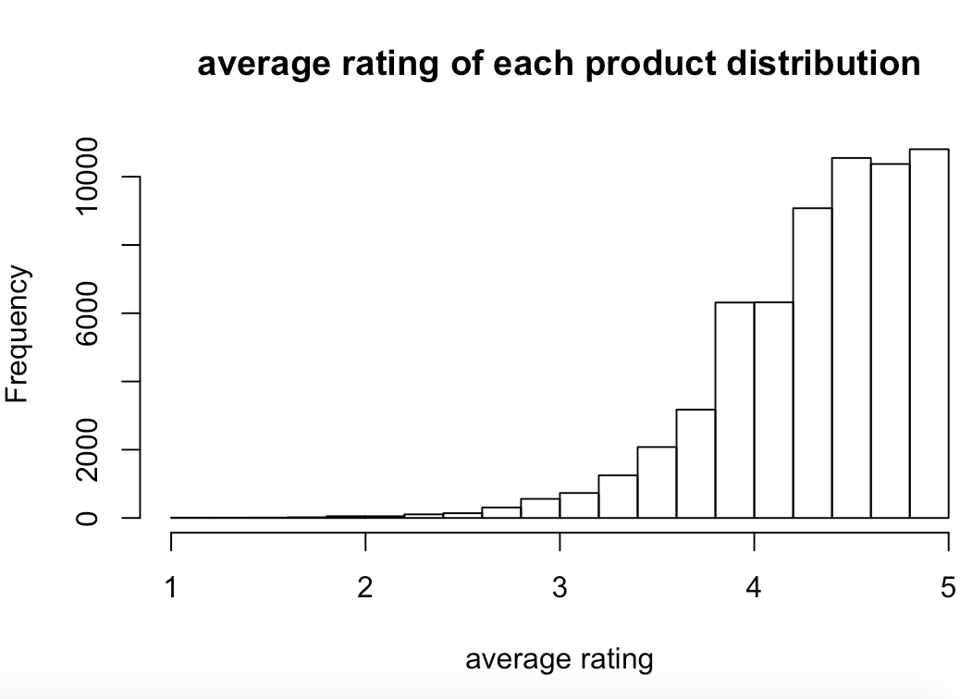
The average rating of each product

Slide 9
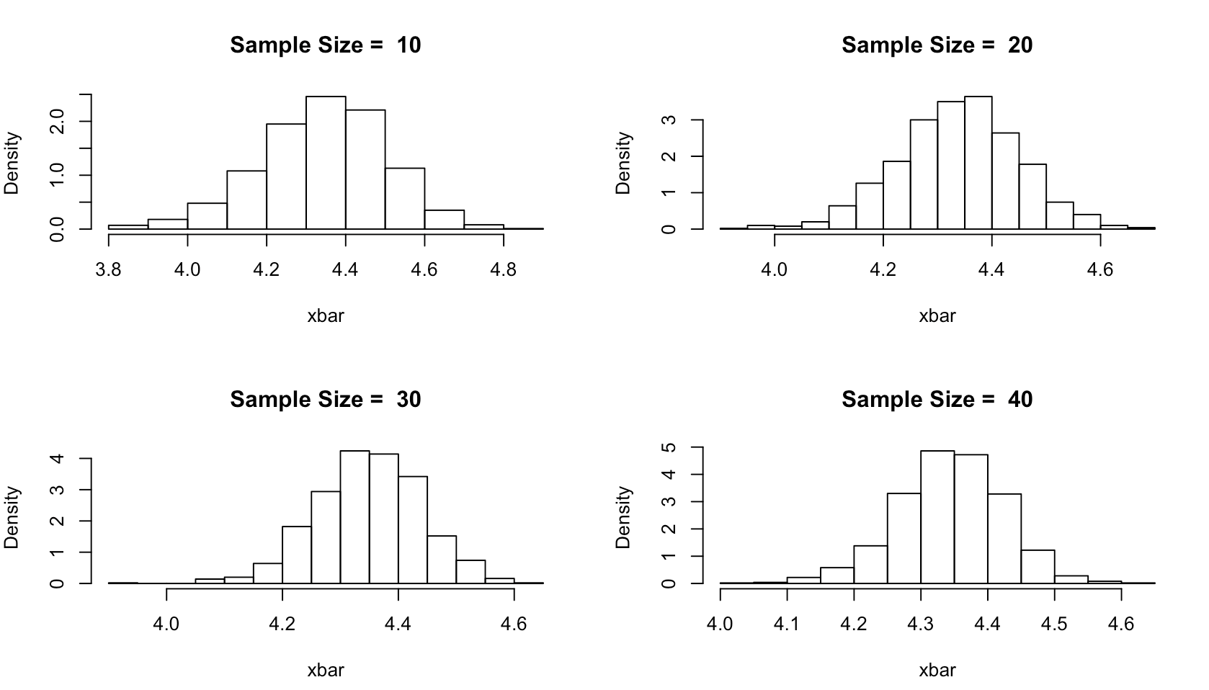
^{Random samples}
Sample Size = 10, Mean = 4.3, SD = 0.16
Sample Size = 20, Mean = 4.3, SD = 0.11
Sample Size = 30, Mean = 4.3, SD = 0.091
Sample Size = 40, Mean = 4.3, SD = 0.079

Slide 10
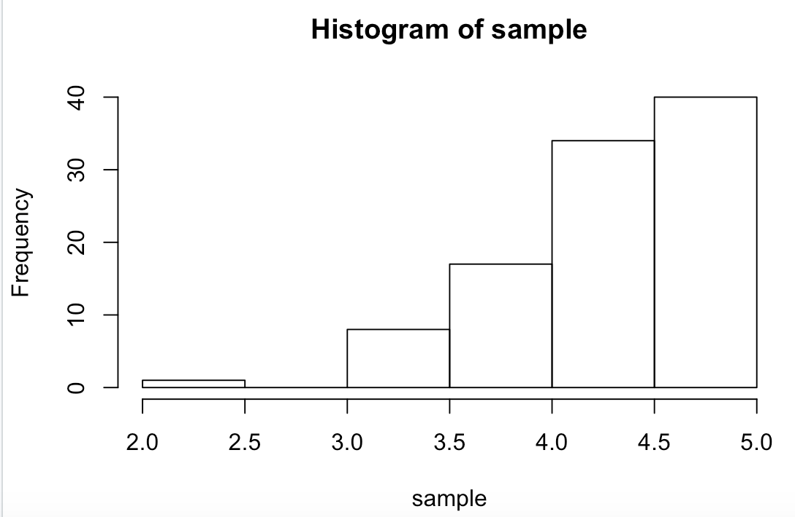
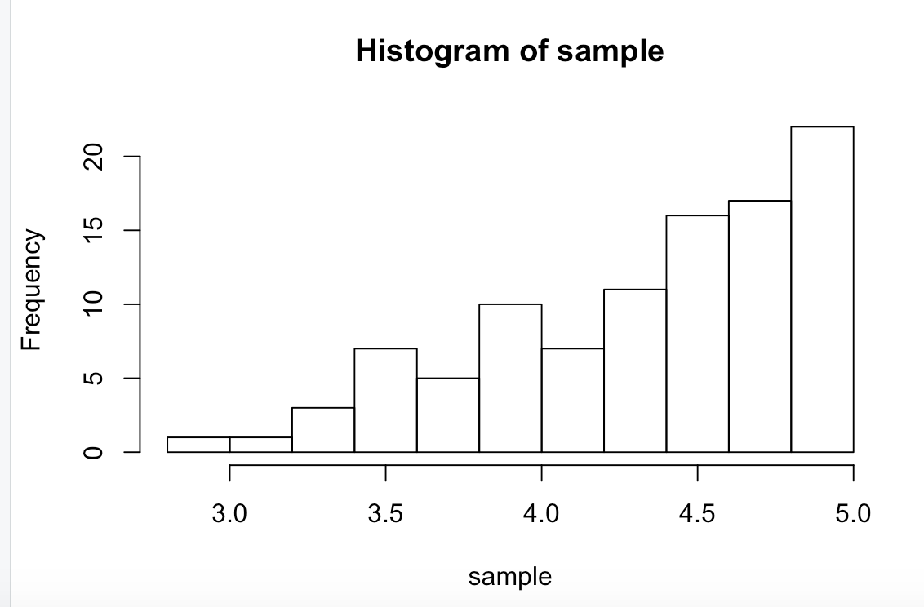
^{Random Sampling}
Simple Random Sampling
Systematic Sampling

Slide 11
Thank You !

